Slide 1




A Comparative Analysis and Predicative Model for Reporting Depression in U.S. Adults
Date: December 3, 2022
Course: Intro to Informatics
Group 12 Project Presentation
Kiran Mai Jaiswal Charpuria, Kruthika Gaddam, Mohith Surya Kiran Kasula, Bala Samantula, Sri Harsha Sudalagunta, April Taylor, Alan Varkey
Indiana University-Purdue University, Indianapolis, USA
InformaticsIUPUI
@IUPUInformatics
soicindy

Slide 2
Background
Depression
28% ↑ in 2020 due to Covid¹
healthcare provider
stigma^{3, 4}
standardized screening increases diagnosis in disparaged groups⁵
280 million people globally in 2019¹
national mental health emergency for children and adolescents²
personal
stigma^{3, 4}
1. World Health Organization. (2022
2. American Academy of Pediatrics, American Academy of Child, and Adolescent Psychiatry, and Children’s Hospital Association,. (2021, 10/19/2021).
3. Hansson, L., Jormfeldt, H., Svedberg, P., & Svensson, B. (2013).
4. Knaak, S., Mantler, E., & Szeto, A. (2017).
5. Garcia, M. E., Hinton, L., Neuhaus, J., Feldman, M., Livaudais-Toman, J., & Karliner, L. S. (2022).

Slide 3
Project Scope
Aims
Purpose
To evaluate any significant mean difference between self-reported and provider-reported cases of depression in adults in the U.S.
To identify and correlate the main factors impacting the reporting of depression by self-reporters and providers in adults in the U.S. and identify the groups that report depression the least.
To develop a multi-variant model that predicts the diagnosis of depression cases from the features of age, gender, income, co-morbidity, medical insurance, education level, and race.
Investigate discrepancies between:
Self-reporting of depression and
Healthcare professional reporting of depression.
Predict specific groups more likely to:
Experience depression and
Be undiagnosed with depression.
The results can be used to improve screening standards for healthcare professionals to increase the diagnosis of depression in the groups that are currently underdiagnosed.

Slide 4
Hypotheses
Null Hypothesis: There will be no increase in the reporting of depression by adults as compared to the reporting of major depressive disorder by healthcare providers in medical records in the US.
Alternate Hypothesis: There will be an increase in the reporting of depression by adults as compared to the reporting of major depressive disorder by healthcare providers in medical records in the US.
Methodology
Comparative analysis between adults and healthcare providers using two datasets to compare depression indicators.
Datasets:
National Health and Nutrition Examination Survey (NHANES)⁶
National Ambulatory Medical Care Survey (NAMCS)⁷
Modeling to predict depression and the factors impacting the reporting of depression by 1) adults and 2) healthcare providers.
Models:
XGBoost
Random Forest
SVM
6. National Center for Health Statistics. (2022b). National Health and Nutrition Examination Survey. National Center for Health Statistics.
7. National Center for Health Statistics. (2018). National Ambulatory Medical Care Survey

Slide 5
Data Collection
Secondary data from National Center for Health Statistics (NCHS):
Surveys and physical examinations
United States (U.S.)
2017 to 2018 (most comprehensive set published since covid pandemic)
NAMCS⁷
Healthcare providers are surveyed and charts examined regarding:
direct patient care received in ambulatory care centers
NHANES⁶
“Mobile examination center” collects data directly regarding:
Nutrition
Diseases
Health behaviors
Demographics
6. National Center for Health Statistics. (2022b). National Health and Nutrition Examination Survey. National Center for Health Statistics.
7. National Center for Health Statistics. (2018). National Ambulatory Medical Care Survey

Slide 6
Data Storage, Extraction, Cleaning
Extraction
NHANES multiple sub-files in XPT format
Downloaded to SAS converter per NCHS recommendation. Saved to CSV file.
Merged per Pandas in Python and extracted columns from large set
NAMCS
Downloaded TXT file from site
Converted with Python to CSV and extracted columns from large set

Slide 7
Cleaning
Missing data calculation
No data over the 10% cutoff in the NHANES dataset per proposal
PHQ questions were calculated, and all had very low missing, refused or unanswered
Team chose to leave them in the dataset and convert to ‘0’. Dropping those rows would lose data in 40+ other variables and other DI measures.
Categorical encoding
Categories converted to Boolean
Variable transformation
Some variables grouped for interpretation or ease in use in analysis
See Depression Indicator slide for description of dependent variable transformation

Slide 8
Depression Indicator
Depression Indicator (DI)
Boolean feature created for each set
Compilation of variables that could indicate depression for each set, , positive for any = yes for DI
NHANES
PHQSCR: PHQ Total>10-- (indicative of depression)
DLQ140: Feelings of depression-- >=Monthly,
DLQ150: Medications for depression-- Yes
DLQ170: Depression Level-- A lot, A little or In between a lot and a little
NAMCS
DEPRN-- depression chronic disease
DEPRESS-- depression screen
MENTAL-- mental health counseling referral
PSYCHOTH—psychotherapist referral
DIAG 1-5 any code with F-code (Diagnosis code) for depression

Slide 9
Data Description
variables after data extraction, cleaning
NHANES-47
NAMCS-39
Variables after engineering
NHANES-29
NAMCS-35

Slide 10
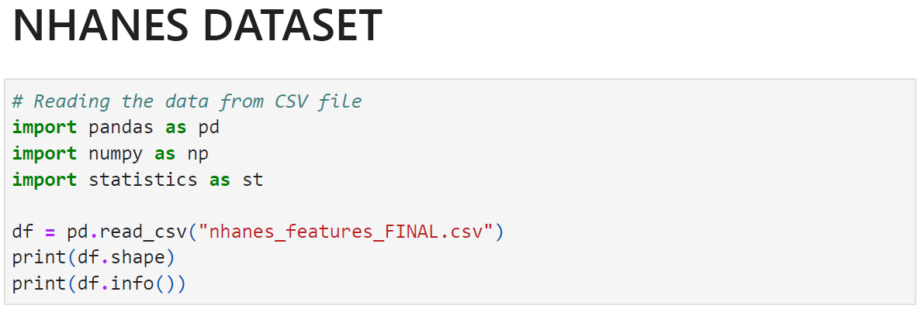
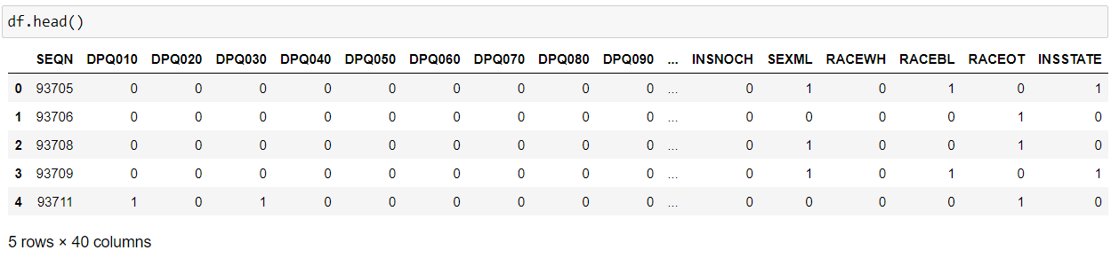
Dataset of NHANES

Slide 11
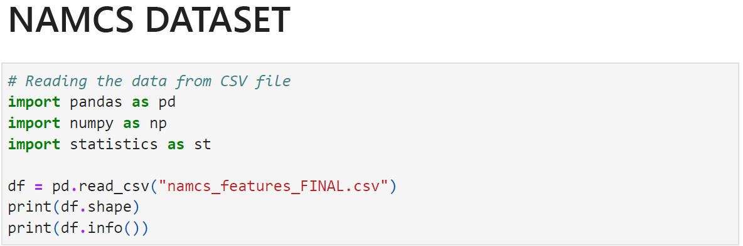
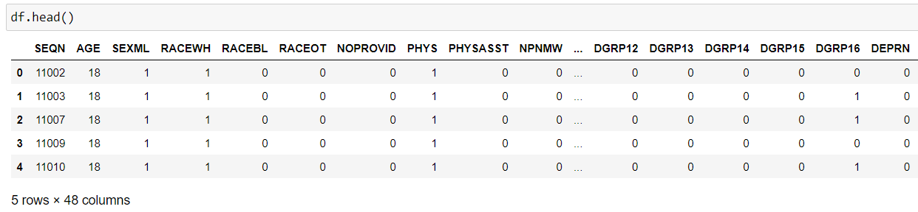
Dataset of NAMCS

Slide 12
Descriptive Statistics
Normality Test using Python
Measures of central tendency with variance & range (each variable)
Skewness and Kurtosis was analyzed. (see appendix slide 33)
According to Hair et al. (2010) and Bryne (2010), data is deemed normal if the skewness is between 2 and +2 and the kurtosis is between 7 and +7.

Slide 13
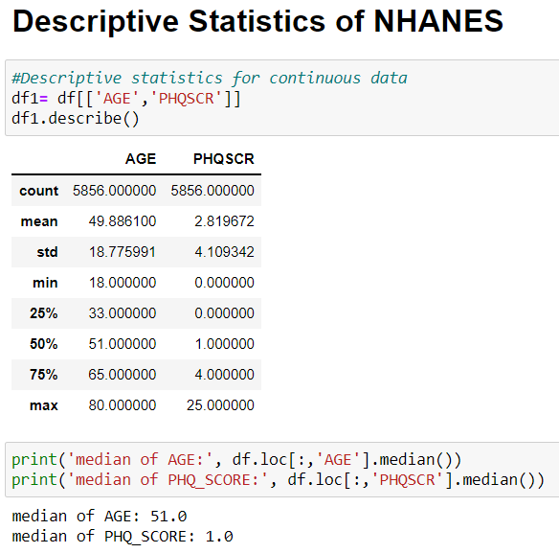
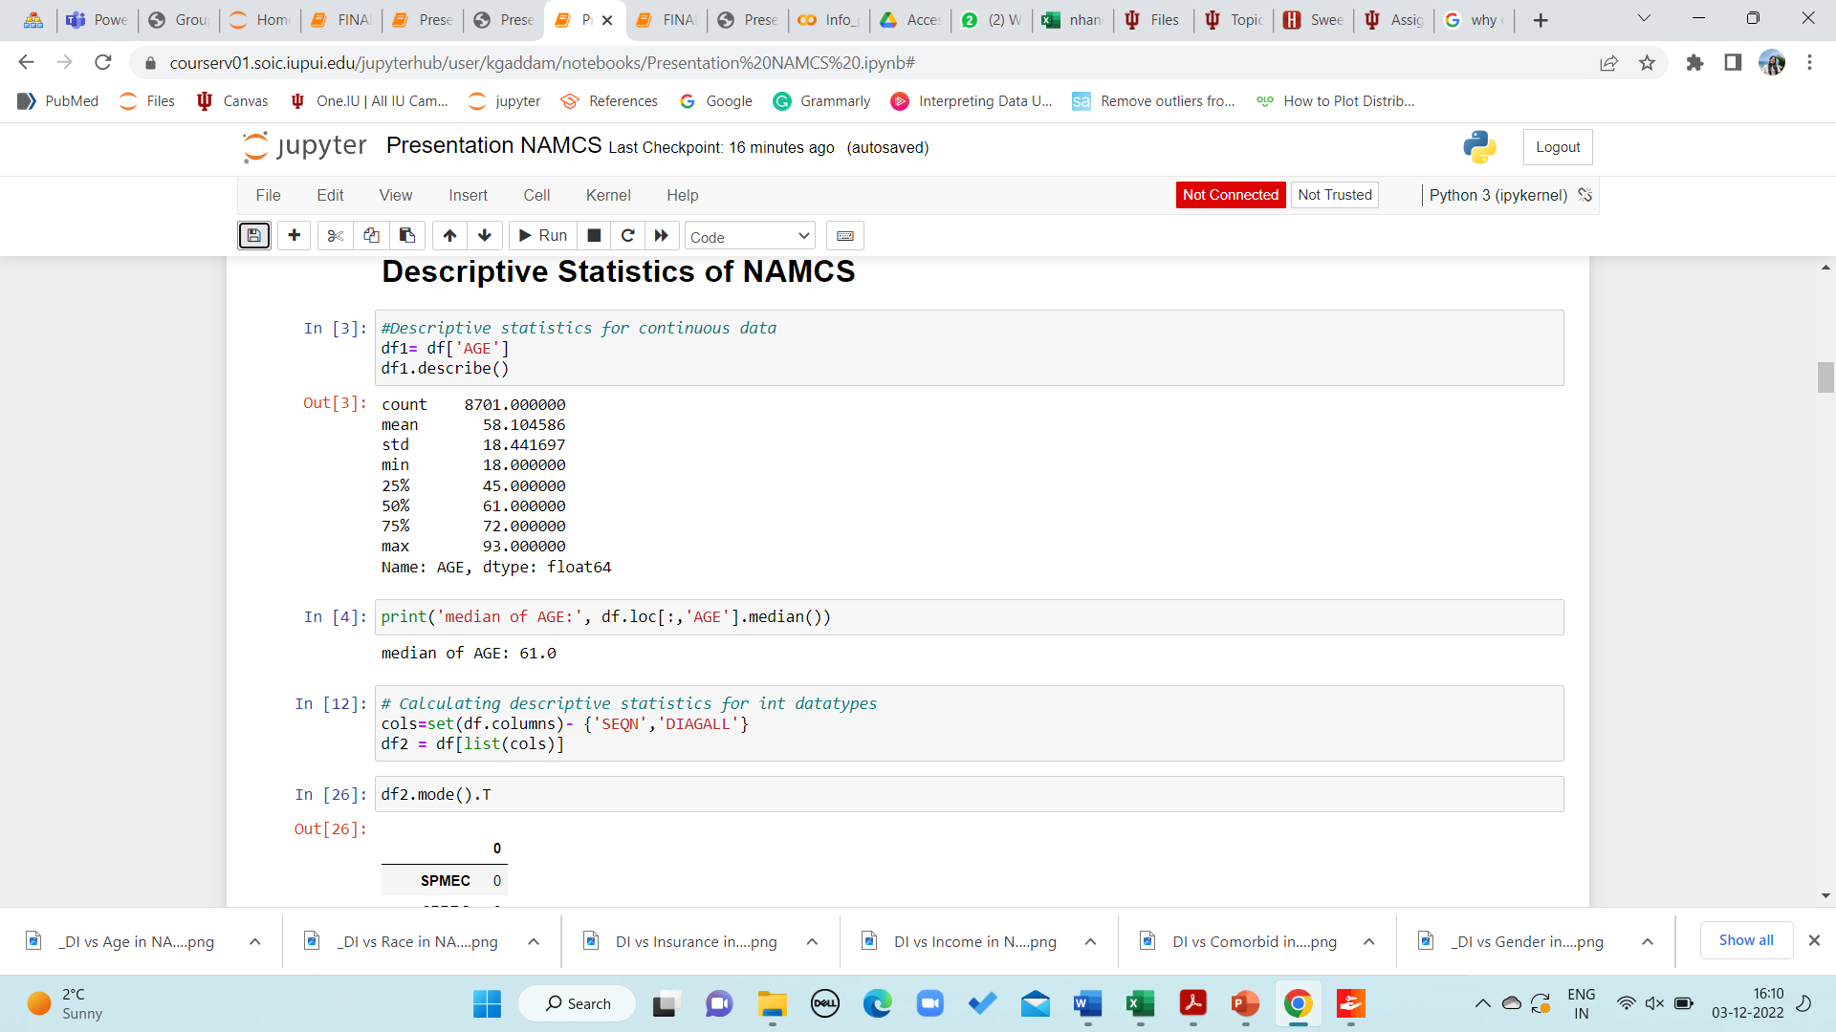
Descriptive Statistics

Slide 14
Data Analysis
Following the descriptive statistics, visualizations were utilized to present data across groups and to determine the influence of the depression indicator on distinct groups.
A stacked bar was used to visualize the relationship between
1. Depression Indicator vs. Age
2. Depression Indicator vs. Relation to Race
3. Depression Indicator vs. Gender
4. Depression Indicator vs. Education
5. Depression Indicator vs. Insurance Types
6. Depression Indicator vs. Types of Providers
7. Depression Indicator vs. relation to co-morbid conditions
The pie chart was used to visualize the percentages of gender, depression, and education.
Histograms of Age, income, education, and gender were plotted to determine each distribution.
A heatmap was created to view and illustrate the correlations between variables in both datasets.

Slide 15
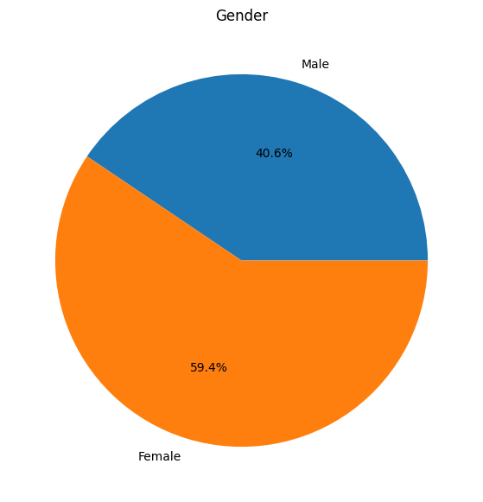
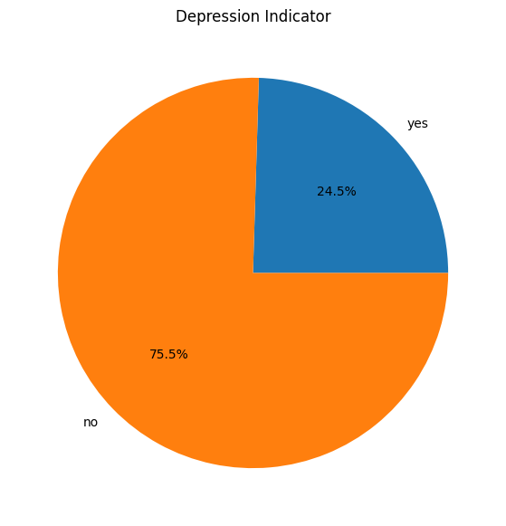
Gender in NHANES
Depression Indicator in NHANES
The gender distribution was found to be 59.4% for Females and 40.6% for Males in NHANES.
The Depression Indicator in NHANES showed a total of 24.5% had depression and 75.5% had no depression.

Slide 16
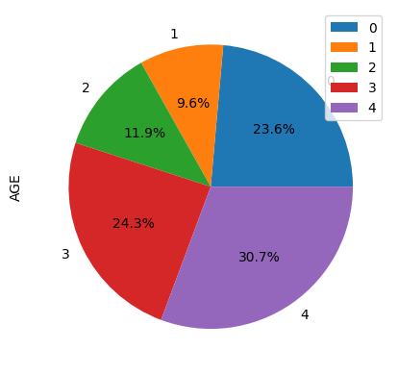
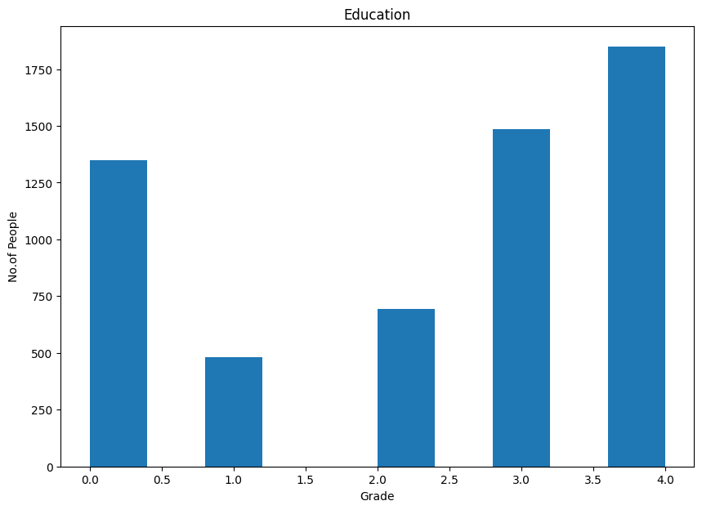
EDUCATION
Education percentage in NHANES
Education Histogram in NHANES
This pie chart shows the Distribution of Education background with respect to AGE.
This Histogram shows educational distribution of the sample from patients with no educational background to patients with higher studies.

Slide 17
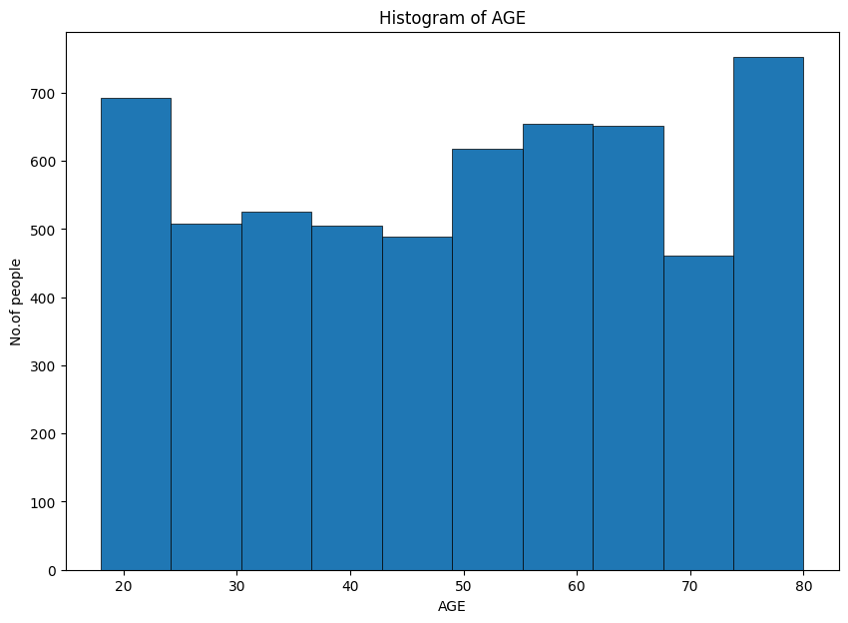
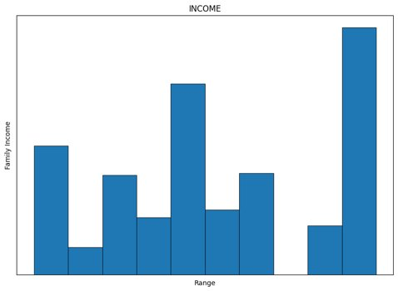
Income in NHANES
AGE Histogram in NHANES
This age distribution NHANES shows that higher patient population were around 80 years of age and the lowest around 70 years.

Slide 18
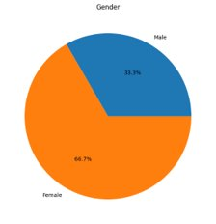
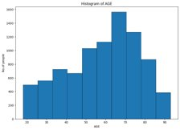
GENDER NAMCS
AGE Histogram in NAMCS
A total of 33.3% Males and 66.7% Females were involved in NAMCS dataset.
The age distribution in NAMCS shows a larger patient group was aged around 70 years and the lowest with 90 years of age.

Slide 19
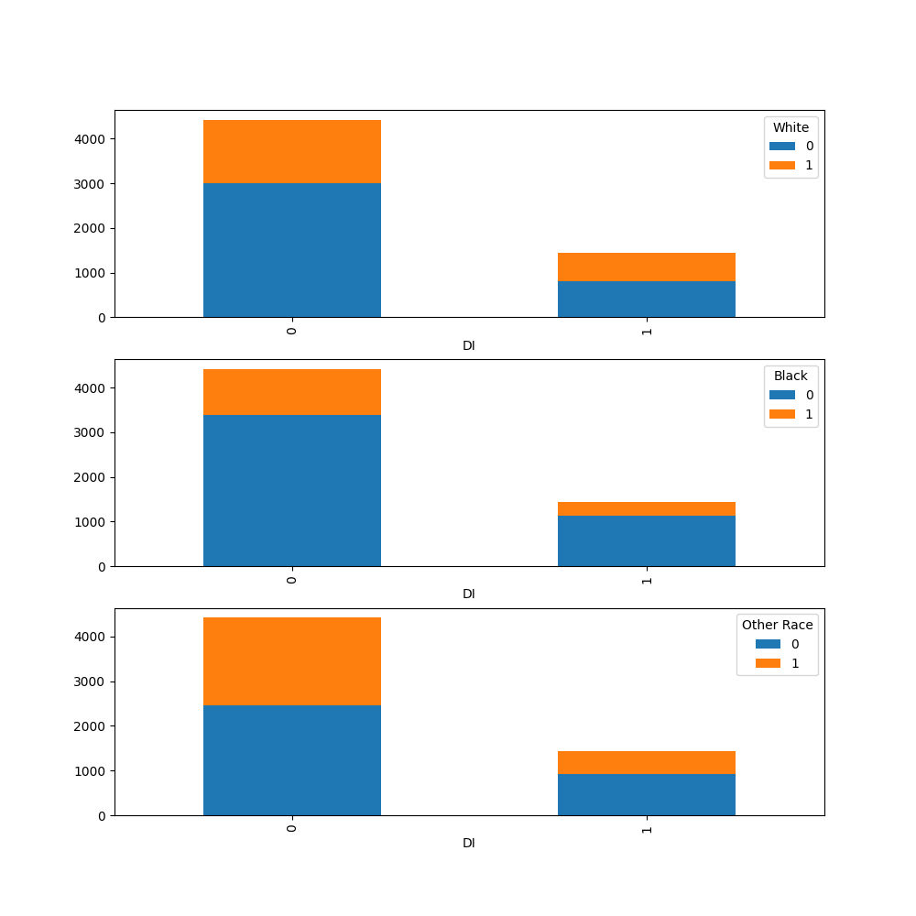
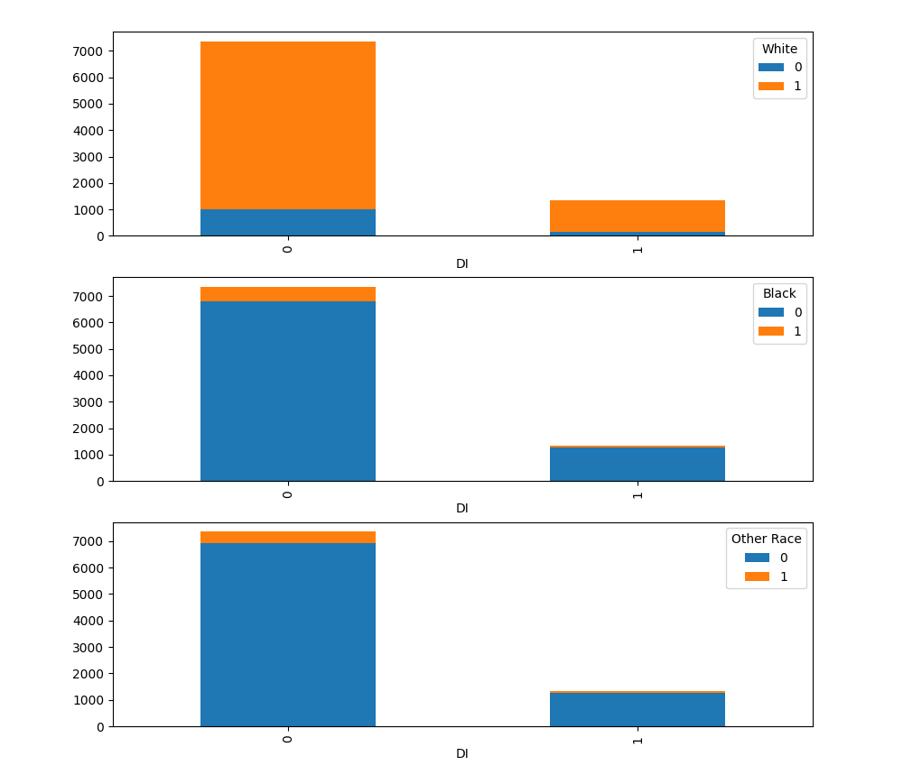
Exploratory Data Analysis
Depression Indicator vs Race in NHANES
Depression Indicator vs Race in NAMCS

Slide 20
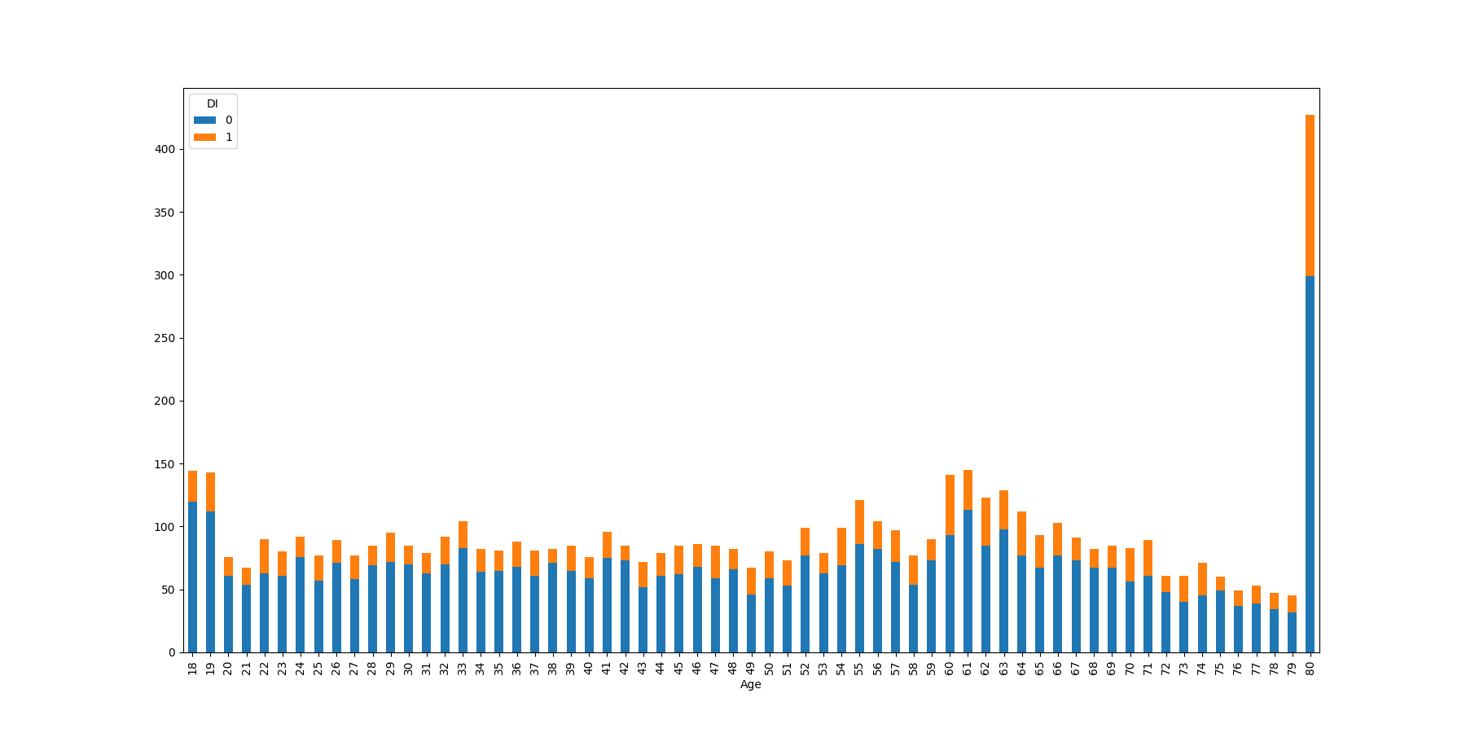
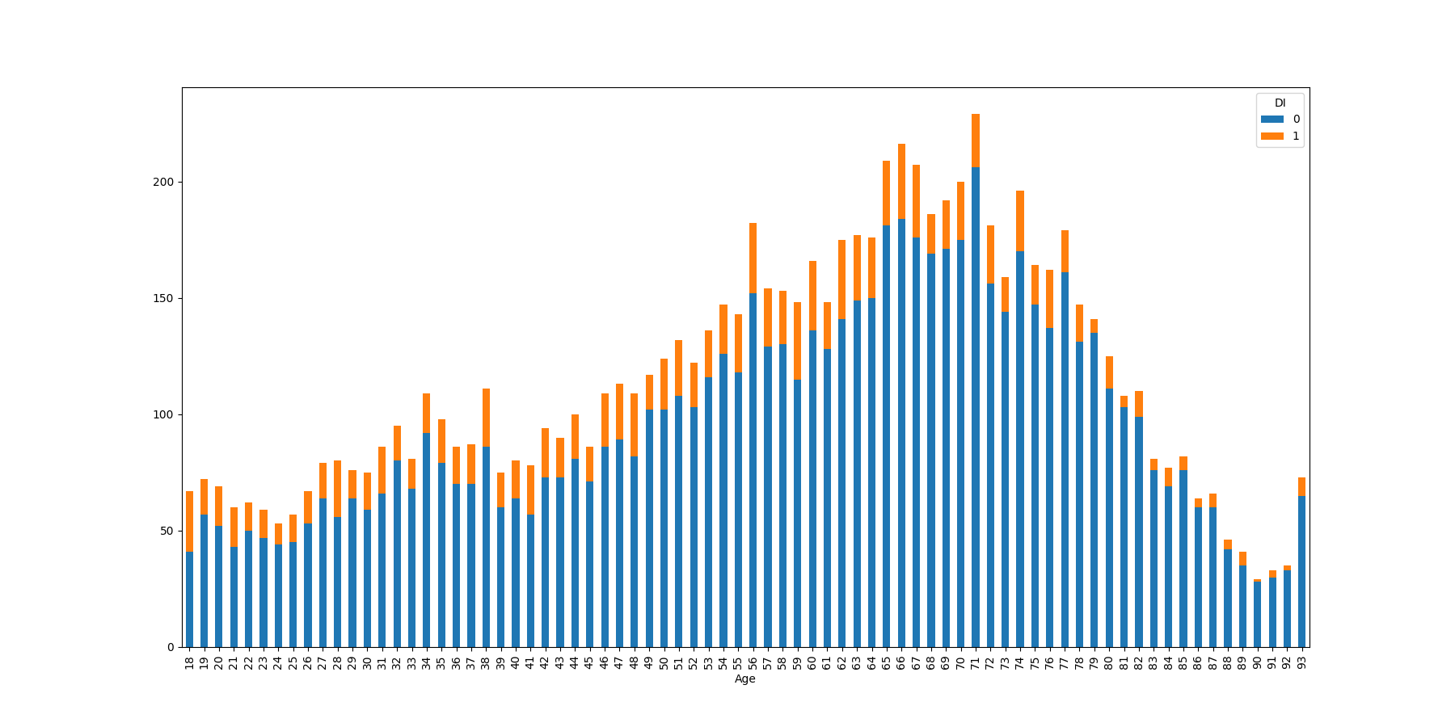
Depression Indicator vs Age in NHANES
Depression Indicator vs Age in NAMCS

Slide 21
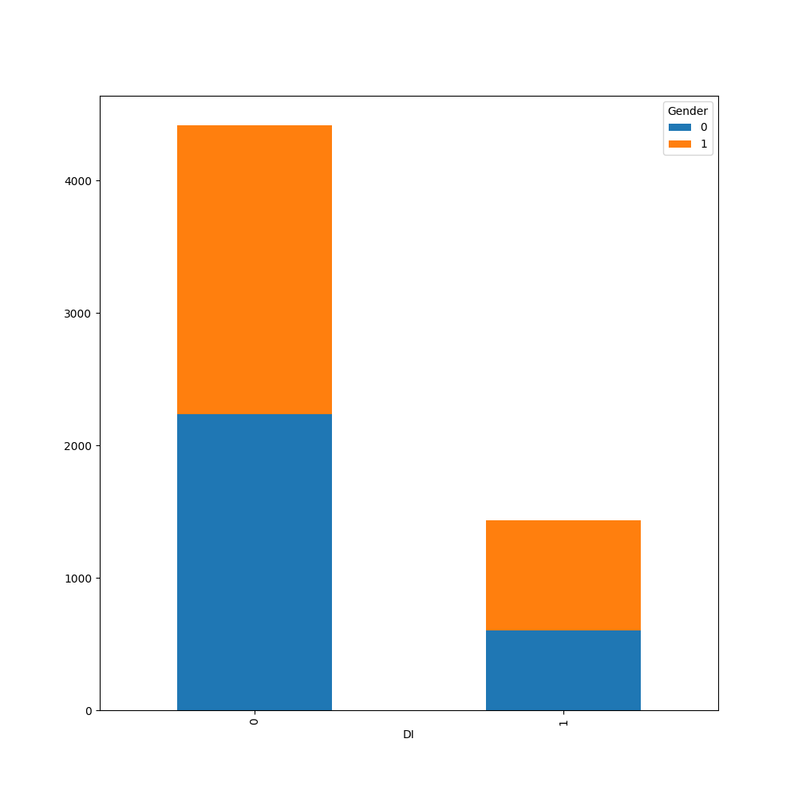
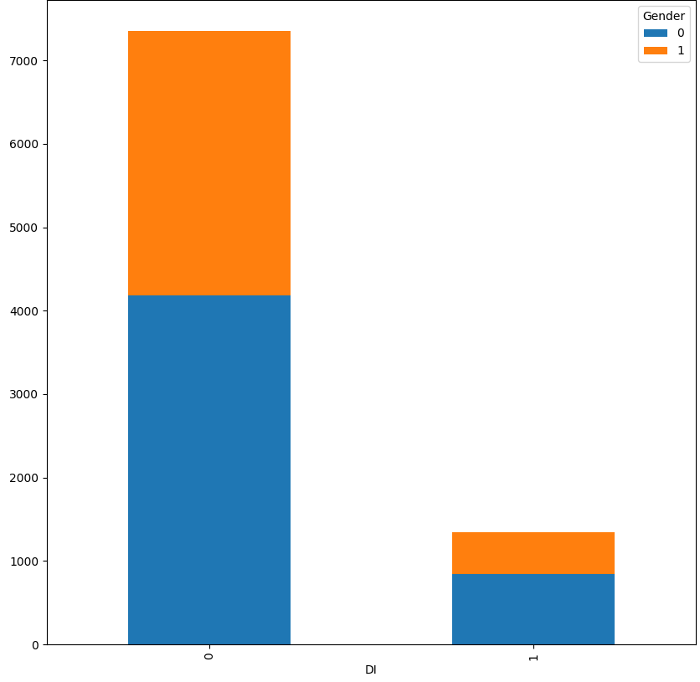
Depression Indicator vs Gender in NHANES
Depression Indicator vs Gender in NAMCS

Slide 22
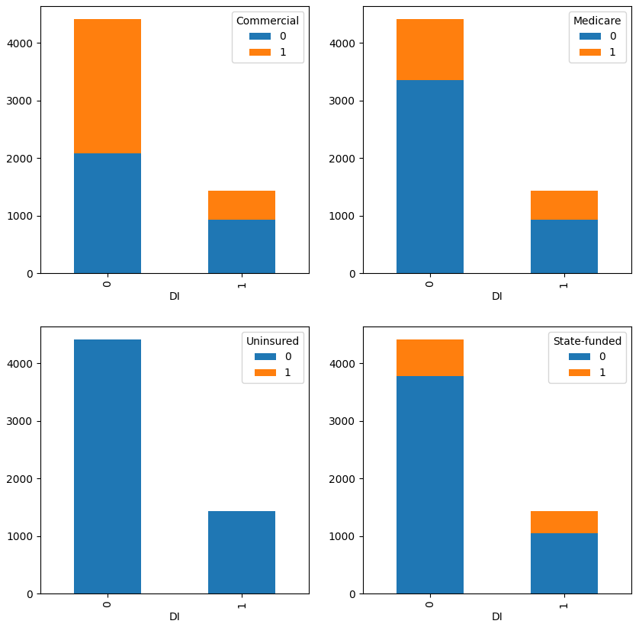
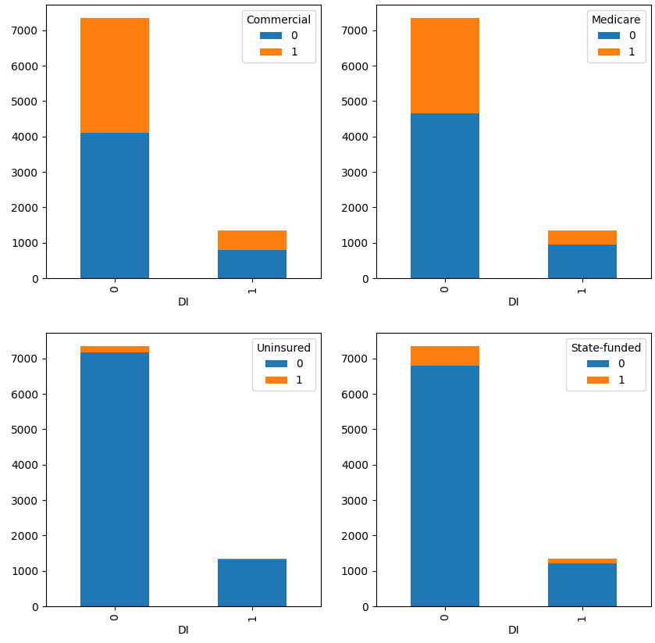
Depression Indicator vs Insurance in NHANES
Depression Indicator vs Insurance in NAMCS

Slide 23
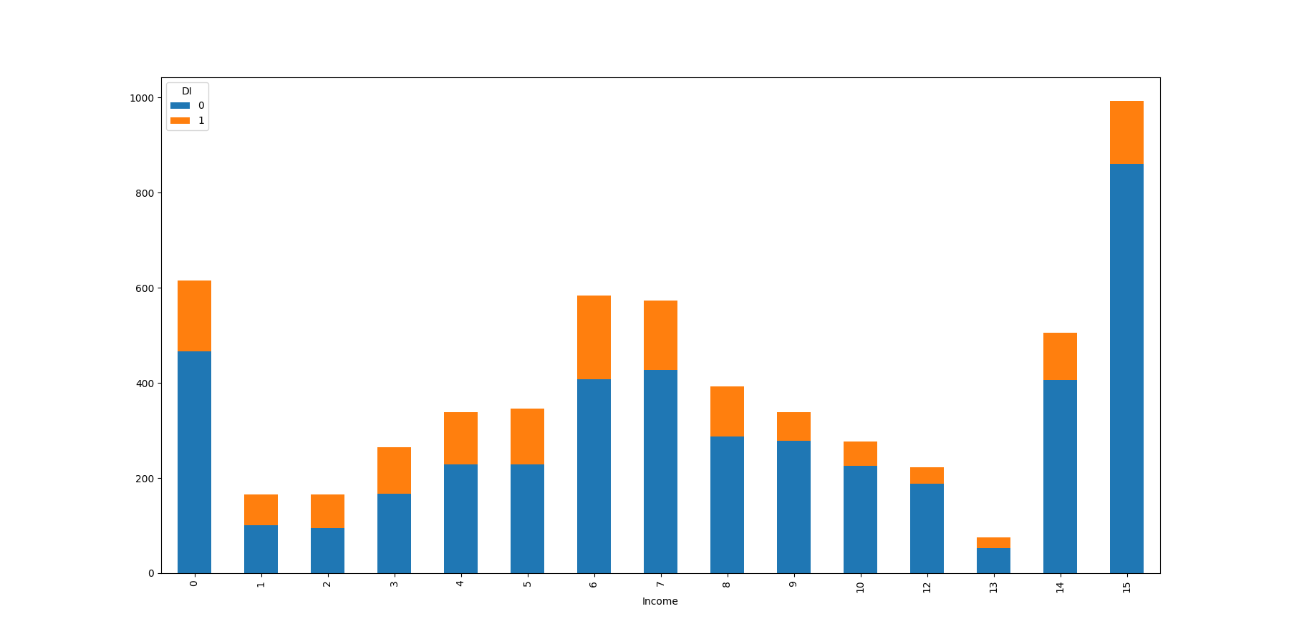
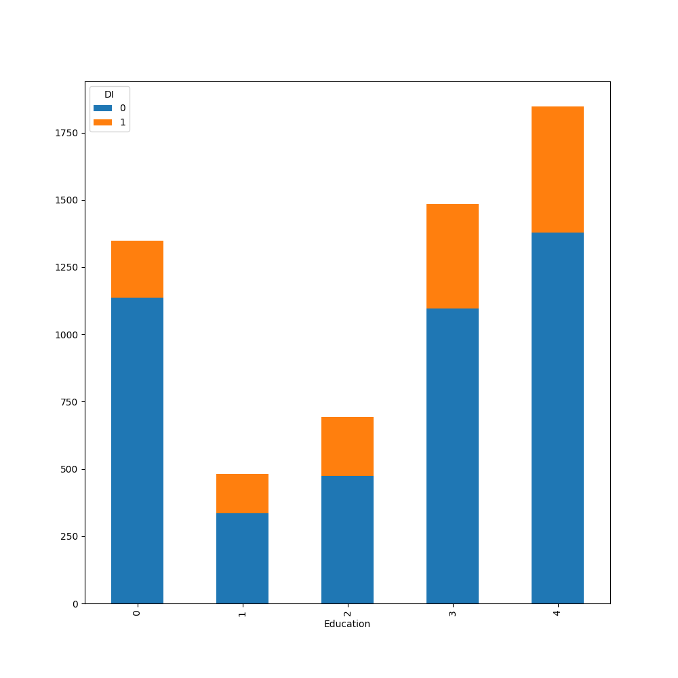
Depression Indicator vs Income in NHANES
Depression Indicator vs Education in NHANES

Slide 24
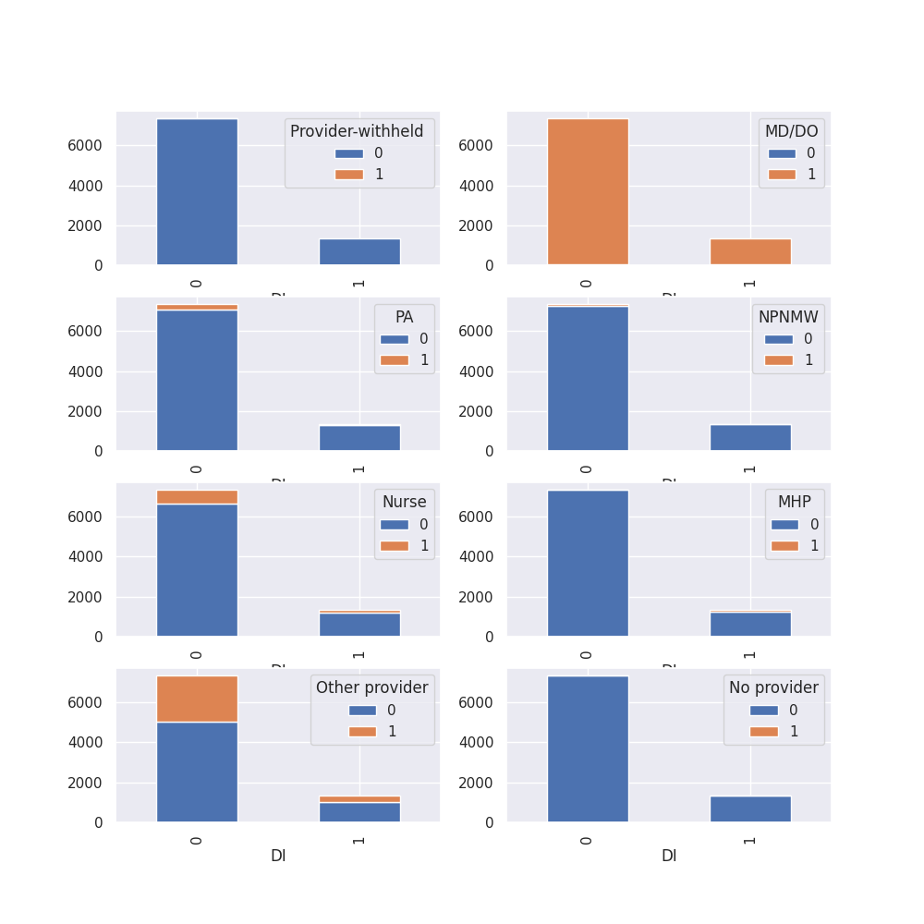
Depression Indicator vs Provider type in NAMCS

Slide 25
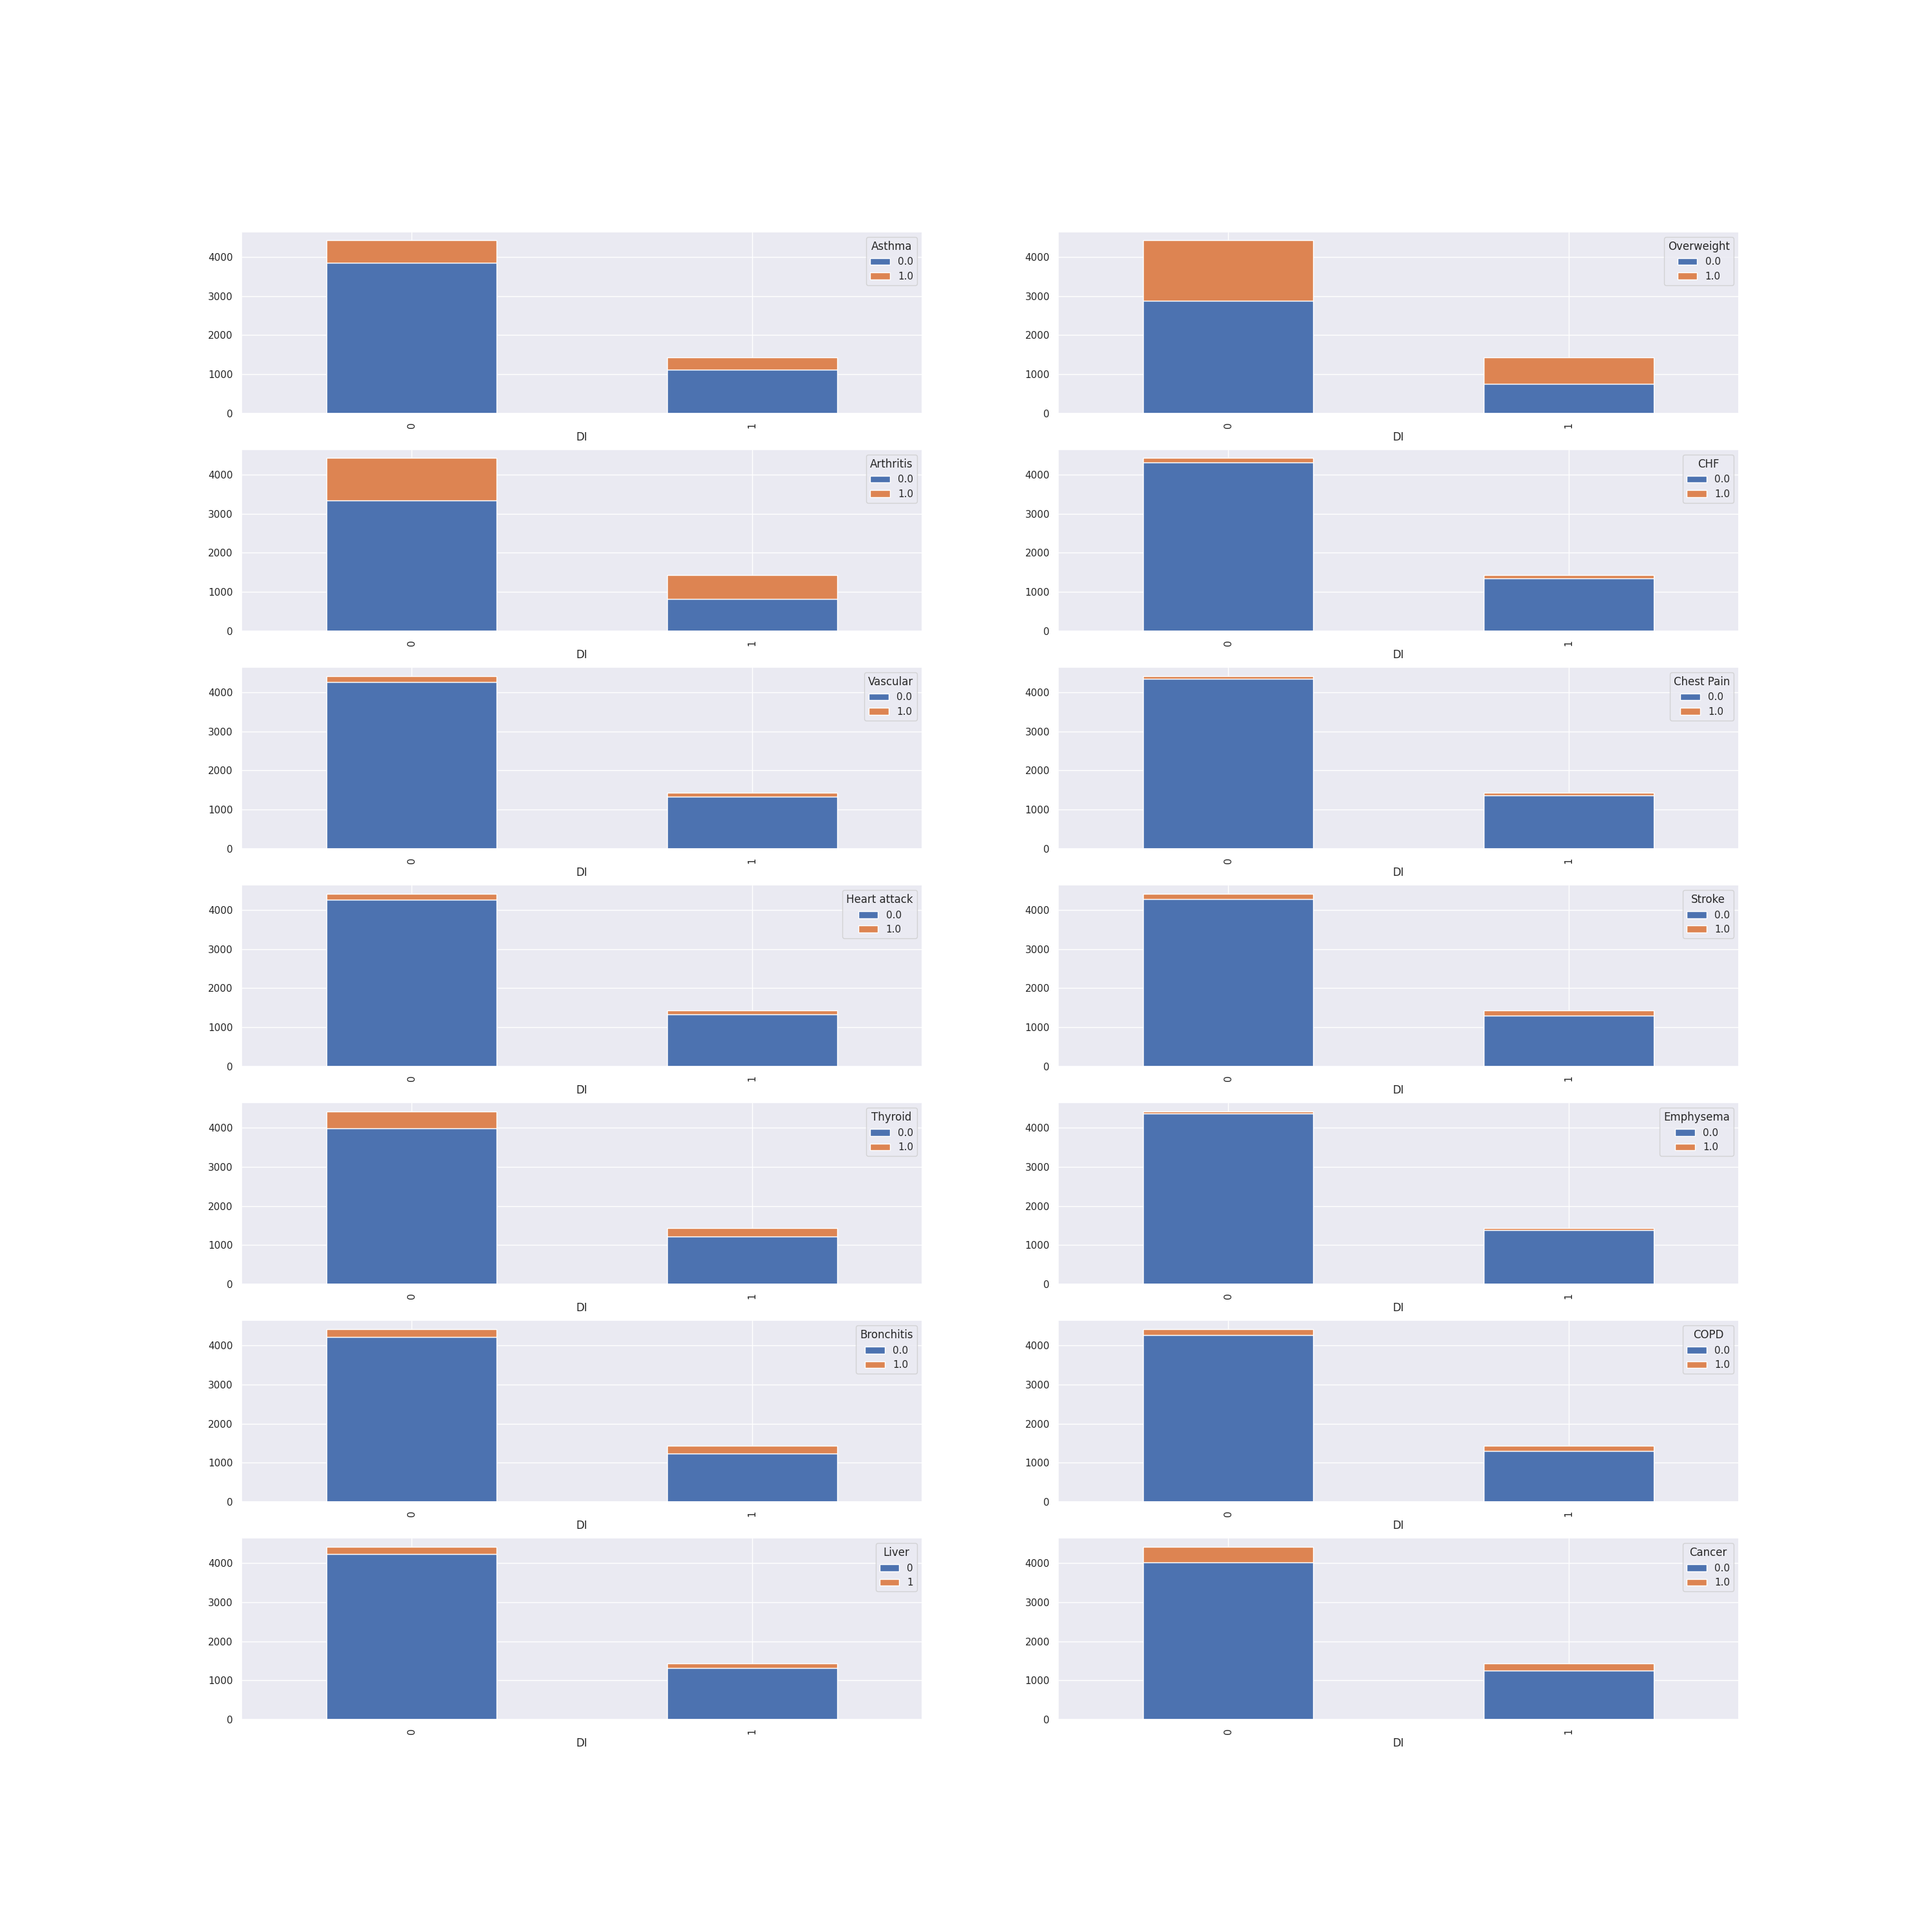
Depression Indicator vs Co-Morbid conditions in NHANES

Slide 26
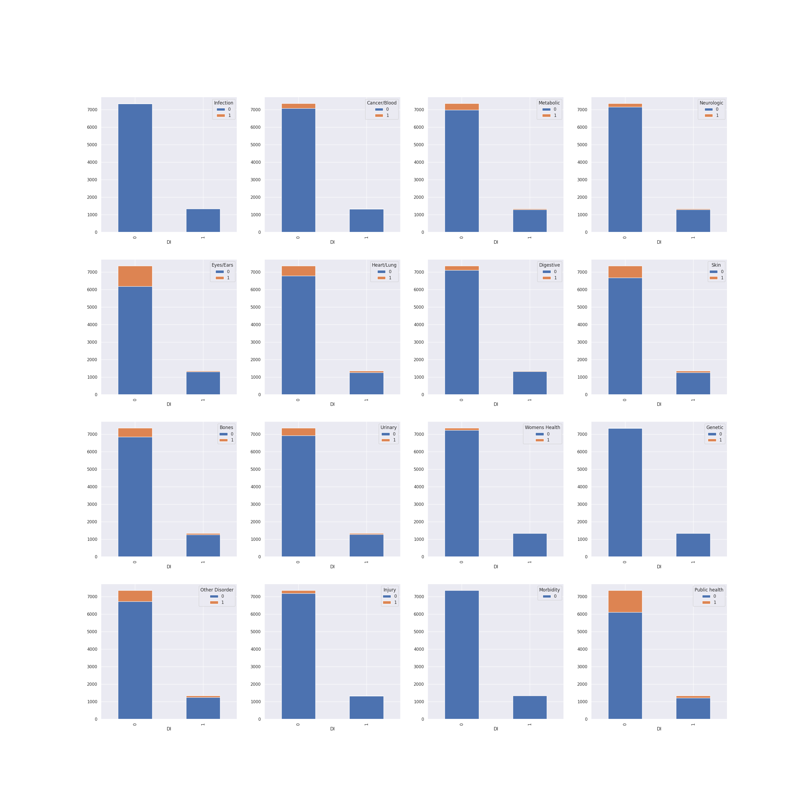
Depression Indicator vs Co-Morbid conditions in NAMCS

Slide 27
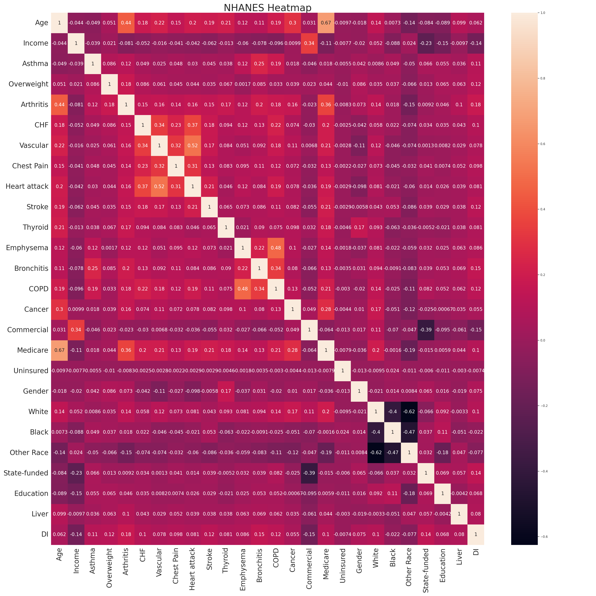

Slide 28
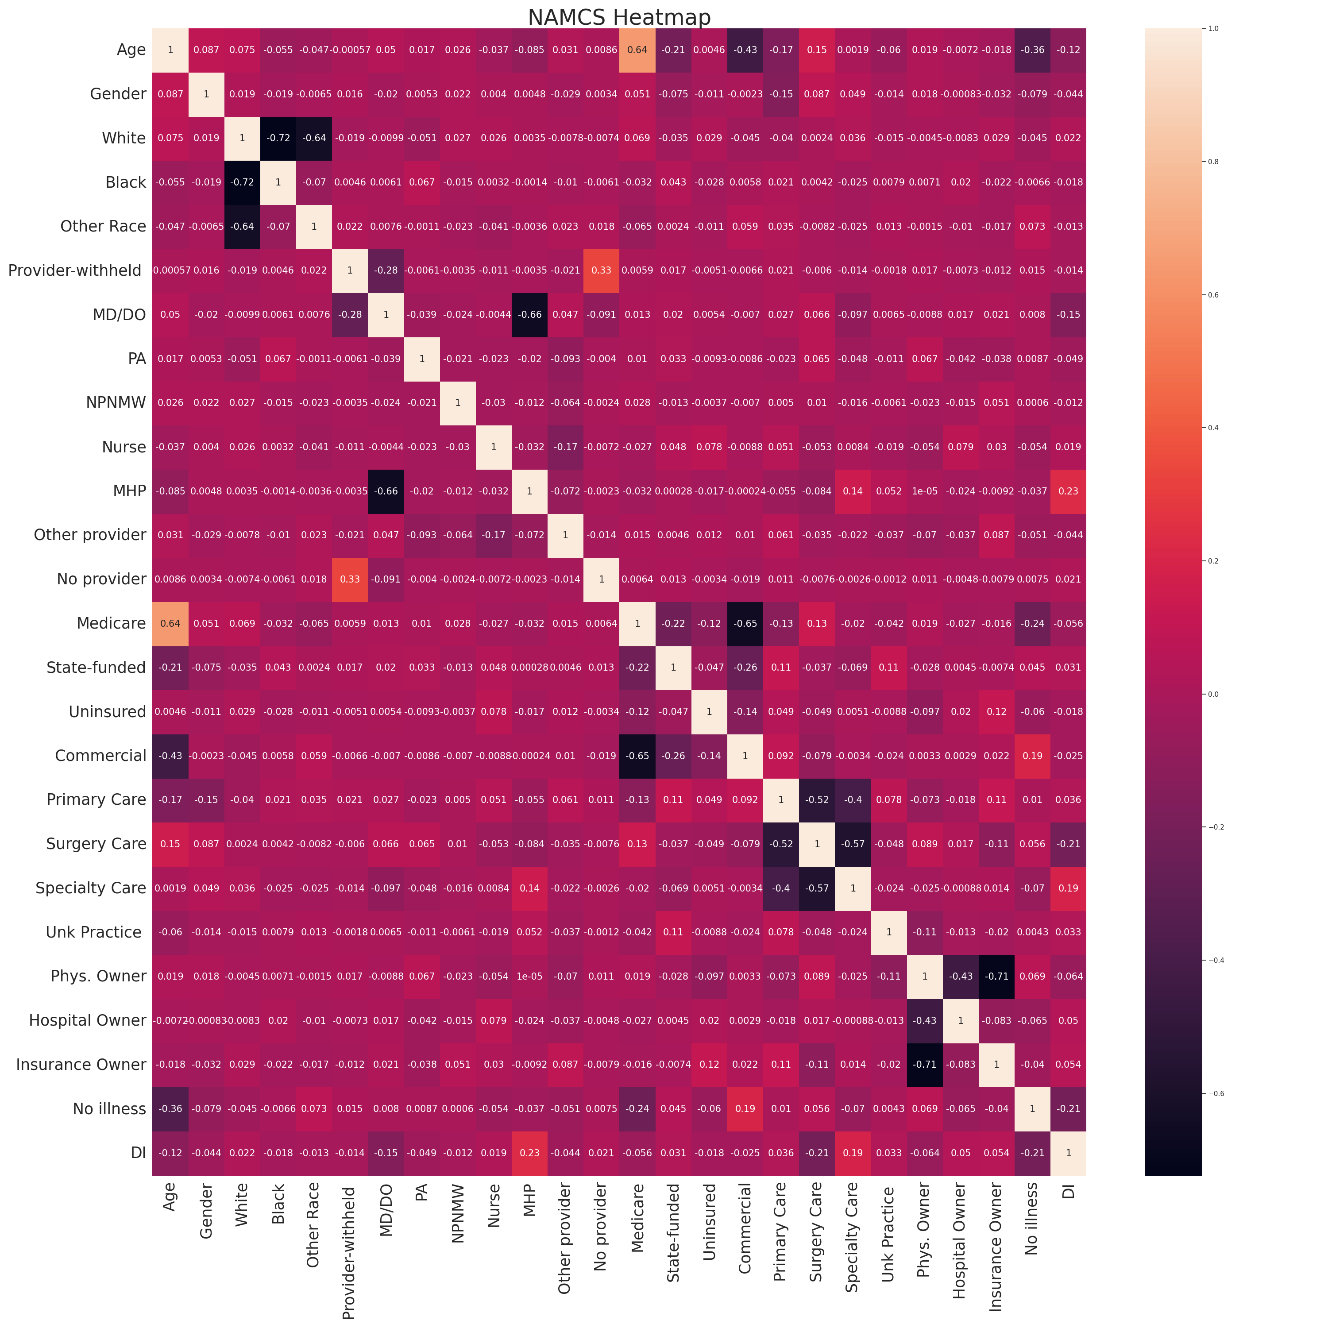

Slide 29
Hypothesis Testing
The chi-square test was utilized for hypothesis testing because both of the data sets contained categorical data.
Even though we mentioned in the draft proposal using a two-sample t test, we employed the chi square test because the data we had was categorical. So we chose Chi Square over the two sample tests.
With the use of the chi-square contingency test, we identified the significant factors from both datasets have an association with the depression indicator.
The significant factors for the depression indicator for both datasets was used to forecast depression using XGBoost, Random Forest and SVM models.

Slide 30
Significant Features found after the Chi Squared test
namcs = ['AGE', 'GENDER', 'RACE-WHITE', 'Physician', 'Physician assistant', 'Mental health provider', 'Other provider', 'Medicare', 'State Insurance', 'Private Insurance', 'Specialty:Primary care', 'Specialty:Surgical care', 'Specialty:Medical care', 'Practice_owner:Unknown', 'Practice_owner:Refused to answer question', 'Practice_owner:Physician or physician group', 'Practice_owner:Medical/Academic health center; other hospital', 'Diagnosis: No chronic conditions', 'Diagnosis: Cancer/Blood', 'Diagnosis: Metabolic', 'Diagnosis: Neurologic', 'Diagnosis: Eyes/Ears', 'Diagnosis: Heart/Lung', 'Diagnosis: Digestive', 'Diagnosis: Skin', 'Diagnosis: Bones', 'Diagnosis: Women\'s Health', 'Diagnosis: Injury', 'Diagnosis: Public Health']
nhanes = ['AGE', 'Month family income', 'MedHistory: Asthma', 'MedHistory: Overweight', 'MedHistory: Arthritis', 'MedHistory: Congestive heart failure', 'MedHistory: Coronary heart disease', 'MedHistory: Angina/Angina Pectoris', 'MedHistory: Heart attack', 'MedHistory: Stroke', 'MedHistory: Thyroid problem', 'MedHistory: Emphysema', 'MedHistory: Chronic Bronchitis', 'MedHistory: COPD', 'MedHistory: Cancer or Malignancy', 'Private Insurance', 'Medicare', 'GENDER', 'RACE-WHITE', 'RACE-OTHERS', 'State Insurance', 'EDUCATION LEVEL', 'MedHistory: Liver issues']

Slide 31
Binary Classification Models
XG BOOST was applied for both significant variables of the datasets NHANES and NAMCS. We employed SMOTE to balance the dataset and to achieve better recall for the model.
We employ Random Forest model too for testing out the datasets for better explaining the pattern in it.

Slide 32
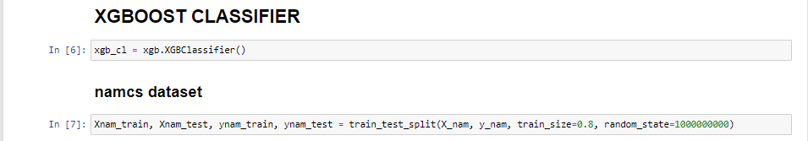
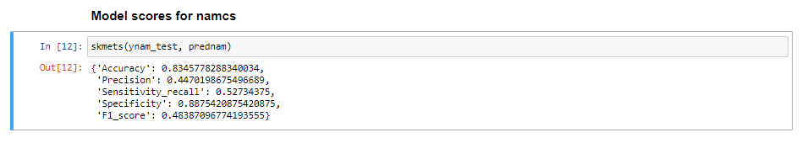
Using XG boost model

Slide 33
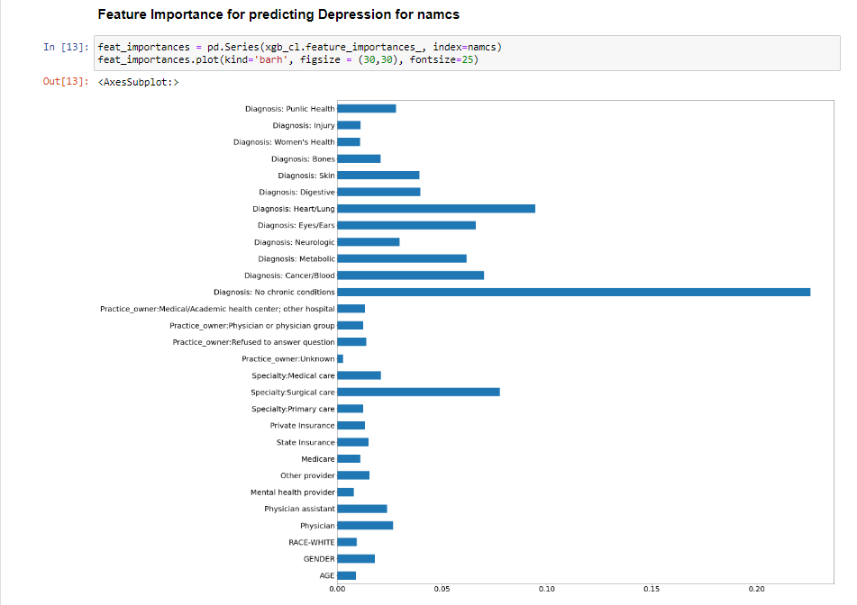

Slide 34
FEATURE IMPORTANCE
Feature Importance depicts the columns that contributed towards the Depression indication and according to the chart, the diagnosis of the patient's medical history has the greater feature importance out of all the NAMCS features provided.

Slide 35
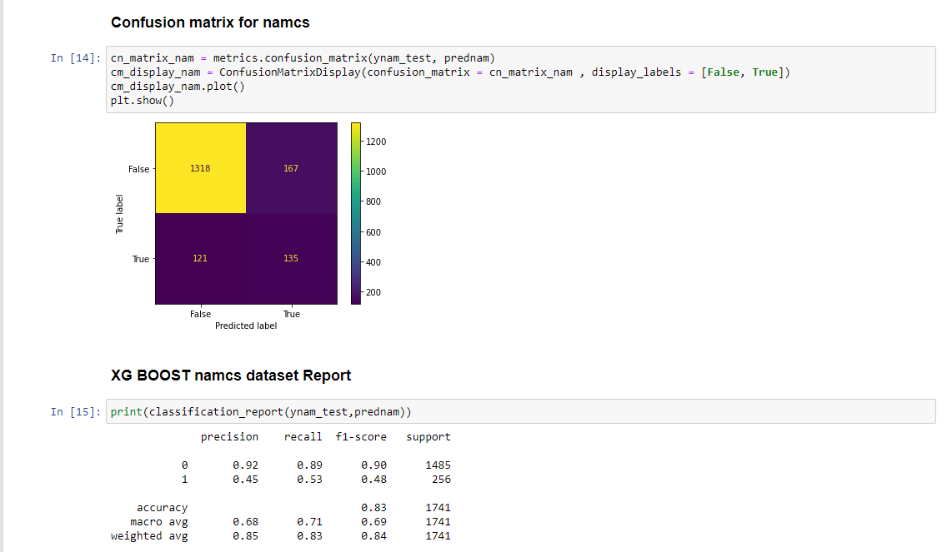

Slide 36
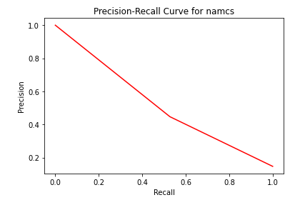
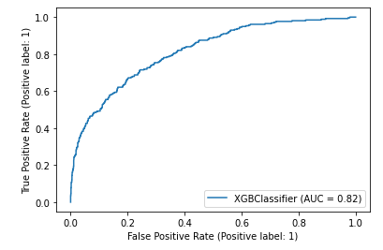
ROC Curve for namcs

Slide 37
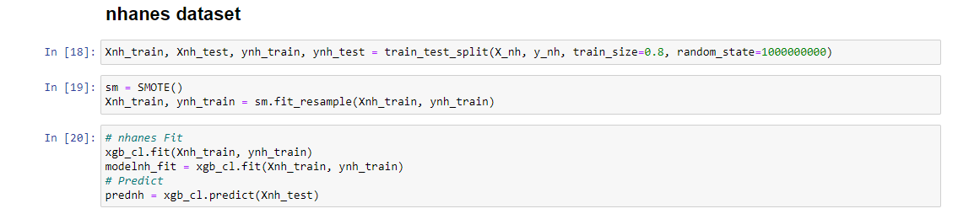
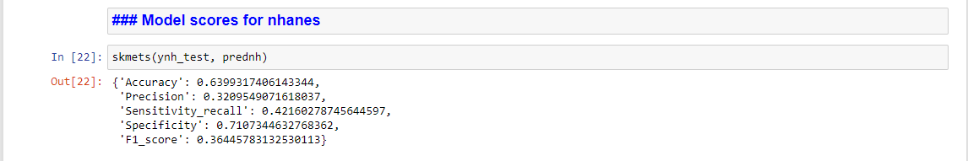

Slide 38
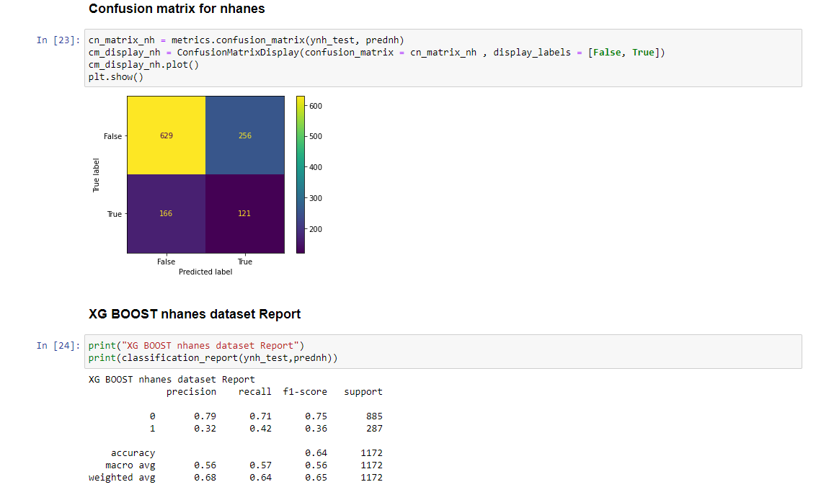

Slide 39
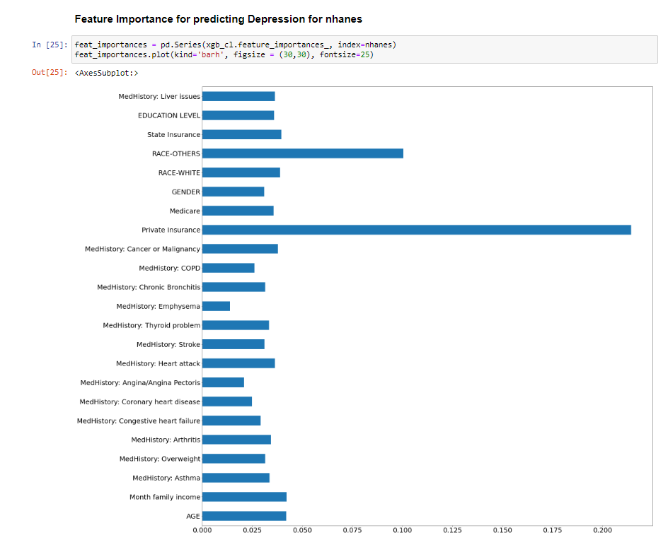

Slide 40
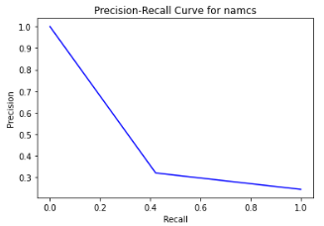
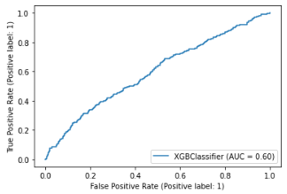

Slide 41

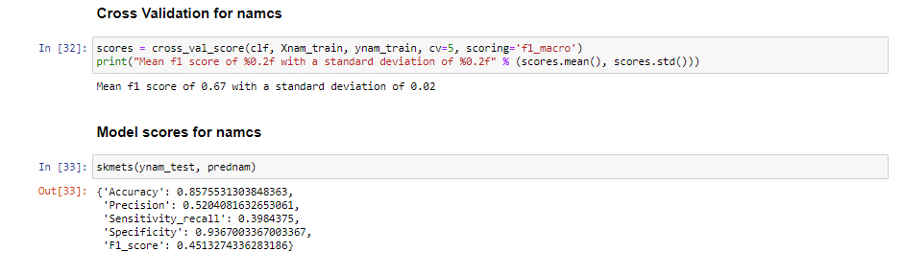
Random Forest Classifier – NAMCS dataset

Slide 42
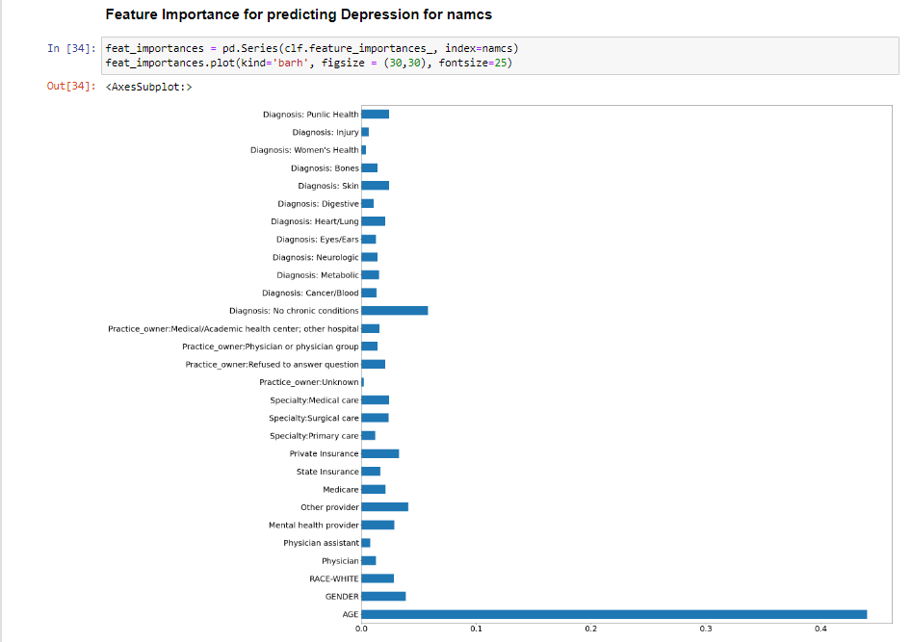

Slide 43
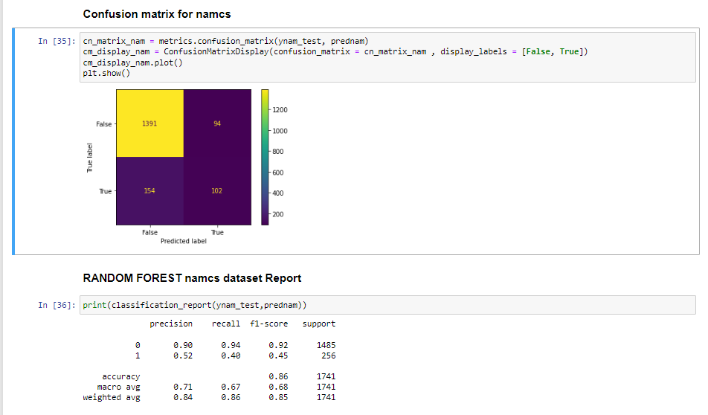

Slide 44
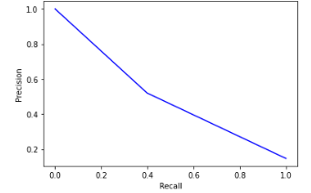
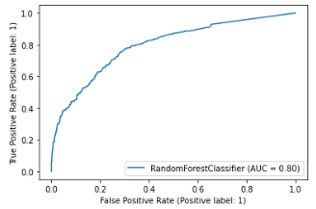

Slide 45
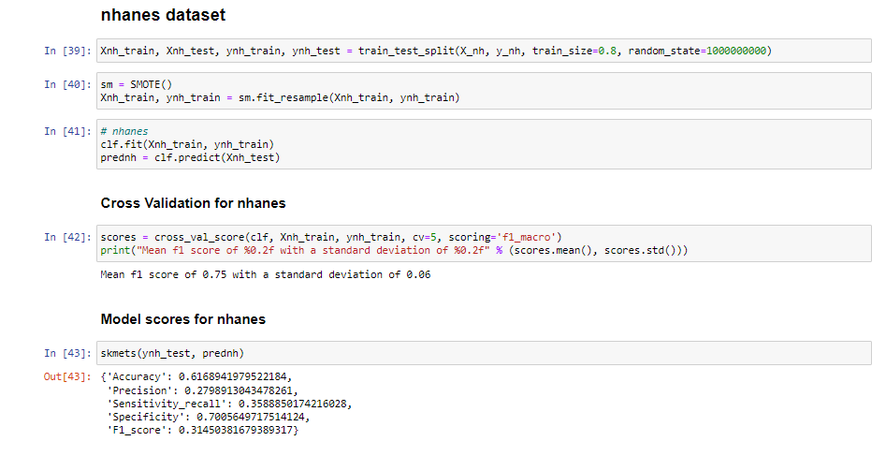

Slide 46
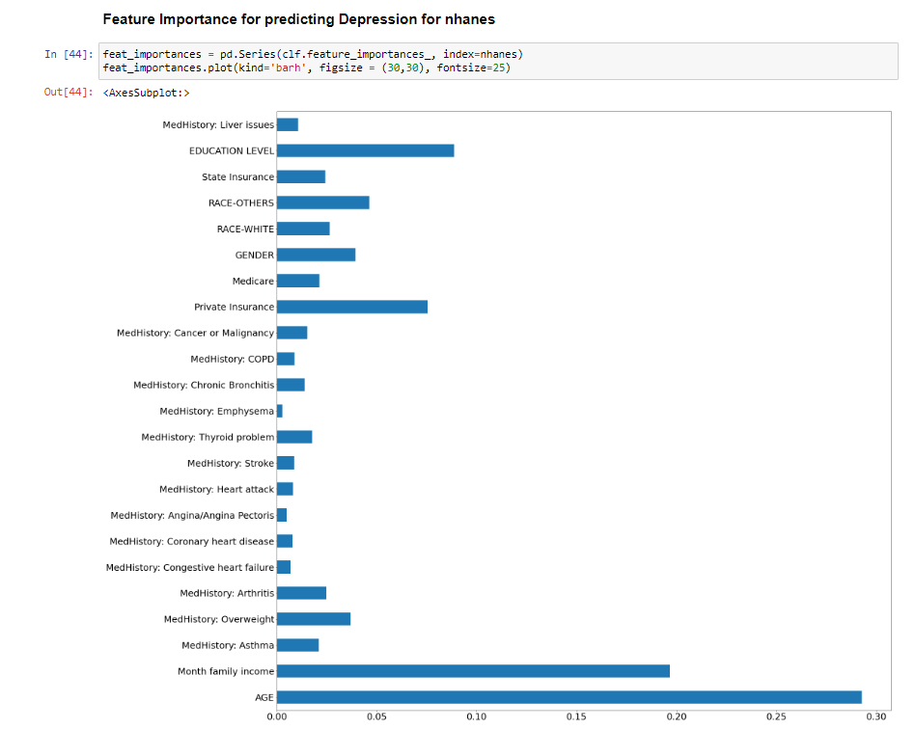

Slide 47
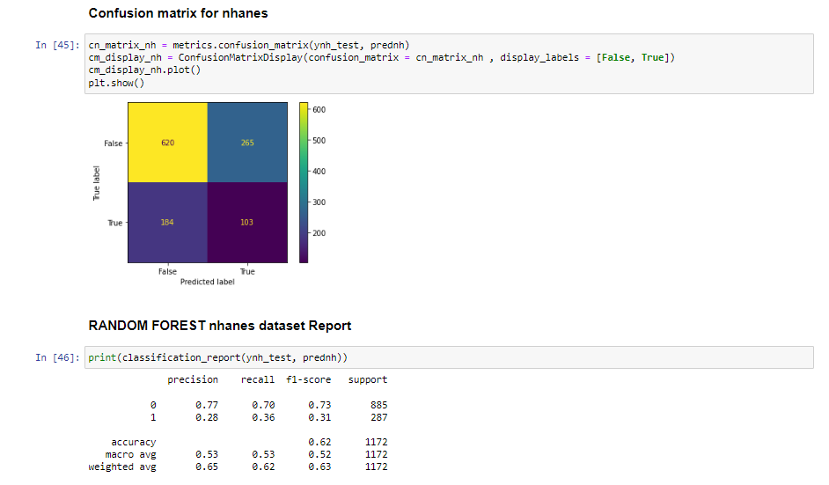

Slide 48
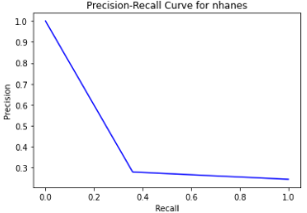


Slide 49
Findings
Both models were able to provide good classification for the nhanes and namcs datasets.
The namcs data was able to provide better classification for the Depression as compared to NHANES survey data.
The diagnosis codes were able to provide a good deal of information to the model to enable the Depression Indicator.
There was found to be a decrease in the depression cases in the nhanes dataset as compared to namcs dataset. Hence, we reject the null hypothesis as there is substantiating evidence to do so.
A person in the NAMCS dataset has higher chance of being detected for depression compared to a person who was surveyed in NHANES.

Slide 50
Conclusion
Hypothesis testing supported the rejection of the null hypothesis
This project was able to demonstrate multiple factors impacting depression and the providers who report depression.
A model was established to support the further development of a survey that can be used to further develop a depression indicator.

Slide 51
Limitations
We used XGBoost and Random Forest instead of SVM because they provide more explanatory power for the datasets we used.
Findings are from two datasets taken from two populations. Conclusions from each set cannot be extrapolated to the other set without further testing.
The datasets are from 2018, collected in 2017. Covid limited more recent data collection. Findings may not represent most resent environments and populations.

Slide 52
Project Management
7-member team
Sub-teams-all members were lead of some aspect of a sub-team though-out the process
Data Discovery & Extractions
Data Cleaning & Engineering
Machine Learning/Modeling
Visualization
Project Management
Process
Weekly Teams meetings 11am Fridays
Teams / Canvas for file storage
WhatsApp for daily direct communications
Canvas for Official communications
Announcements
Communications with course staff/professor
phpAdmin(mySQL)/Colab- file storage
Wrike Software for Project timeline development and tracking
Challenges:
Datasets complex and difficult to convert from XPT
Two datasets increased complexity
Most variables were categorical challenging the analysis
Phpmyadmin site was challenging with these datasets

Slide 53
Appendix

Slide 55
References
1. World Health Organization. (2022). Mental Health and COVID-19: Early evidence of the pandemic’s impact (WHO/2019-nCoV/Sci_Brief/Mental_health/2022.). https://www.who.int/publications/i/item/WHO-2019-nCoV-Sci_Brief-Mental_health-2022.1
2. American Academy of Pediatrics, American Academy of Child, and Adolescent Psychiatry, and Children’s Hospital Association,. (2021, 10/19/2021). AAP-AACAP-CHA Declaration of a National Emergency in Child and Adolescent Mental Health. Retrieved 09/30/2022 from https://www.aap.org/en/advocacy/child-and-adolescent-healthy-mental-development/aap-aacap-cha-declaration-of-a-national-emergency-in-child-and-adolescent-mental-health/
3. Hansson, L., Jormfeldt, H., Svedberg, P., & Svensson, B. (2013). Mental health professionals' attitudes towards people with mental illness: do they differ from attitudes held by people with mental illness? Int J Soc Psychiatry, 59(1), 48-54. https://doi.org/10.1177/0020764011423176
4. Knaak, S., Mantler, E., & Szeto, A. (2017). Mental illness-related stigma in healthcare. Healthcare Management Forum, 30(2), 111-116. https://doi.org/10.1177/0840470416679413
5. Garcia, M. E., Hinton, L., Neuhaus, J., Feldman, M., Livaudais-Toman, J., & Karliner, L. S. (2022). Equitability of Depression Screening After Implementation of General Adult Screening in Primary Care. JAMA Network Open, 5(8), e2227658-e2227658. https://doi.org/10.1001/jamanetworkopen.2022.27658
6. Hair, J., Black, W. C., Babin, B. J. & Anderson, R. E. (2010) Multivariate data analysis (7th ed.). Upper Saddle River, New Jersey: Pearson Educational International.

Slide 56
Codes

Slide 57
Codebook

Slide 58


Finding Missing values in NAMCS

Slide 59


Limit NAMCS Source File to Project Variables

Slide 60


Merging NHANES Source

Slide 61

NAMCS Cleaning and Feature Engineering

Slide 62



Slide 63


Slide 64


Slide 65


Slide 66



Slide 67


Slide 68


Slide 69


Slide 70



Slide 71

Finding Missing values in namcs.csv

Slide 72

NHANES Cleaning and Feature Engineering

Slide 73


Slide 74


Slide 75


Slide 76


Slide 77


Slide 78



Slide 79


Slide 80


Slide 81


Slide 82


Slide 83


Slide 84


Slide 85


Slide 87


Descriptive Statistics of NHANES

Slide 88


Descriptive Statistics of NAMCS

Slide 89


EXPLORATORY DATA ANALYSIS

Slide 90


Slide 91


Slide 92



Slide 93


Slide 94




Slide 95


Code for Data Visualization ( PIE, Histogram) - NHANES

Slide 96

Code for Data Visualization ( PIE, Histogram) - NAMCS

Slide 97

Hypothesis Testing
Finding Significant variables among the two datasets

Slide 98

NHANES Dataset Significant Variables

Slide 99

NAMCS dataset significant variables

Slide 100


Significant variables from both the datasets
Merging the Significant variables from Both the Datasets

Slide 101

Processing of Merged dataset

Slide 102


Slide 103

Using Models for answering the Hypothesis Question and selecting best model for prediction of depression

Slide 104


Slide 105


Slide 106


Slide 107


Slide 108


Slide 109


Slide 110


Slide 111


Slide 112


Slide 113


Slide 114


Slide 115


Slide 116


Slide 117


Slide 118


Slide 119


Slide 120


Slide 121


Slide 122


Slide 123


Slide 124


Slide 125


Slide 126
END

